Slide 1
START CLASSES
Group Members
- Le Thuc Minh Tien (Leader)
- Nguyen Phan Dieu Ngoc
- Nguyen Mau Lan
- Bui Quang Huy
INSTRUCTOR: MR. LE QUOC DUNG

Slide 2
TABLE OF CONTENT
I. ACKNOWLEDGEMENTS
II. INTRODUCTION
III. PROBLEM DEFINITION AND GUI OF WEBSITE
IV. USECASE & SITE MAP
V. TECHNICAL
VI. CONCLUSION
VII. REFERENCE
VI. CHECK LIST

Slide 3
I.
ACKNOWLEDGEMENTS

Slide 4
“We wish to express our deep gratitude to the e-Project Team at the Head office, who guided and helped us. Particular thanks to Mr. Le Quoc Dung who suggested the “form validation” and help us connect storage to our project, develop the analysis proceeding from it, and debugging code. We also would like to express our great gratitude to all the student members of our center (Softech Aptech). ”

Slide 5
II.
INTRODUCTION

Slide 6
INTRODUCTION
Star Classes is into business for more than a decade. They have been advertising about their coaching classes through newspapers, pamphlets, television. Now with changing times, they have decided to go online as most of the students today are frequent users of Internet. They have planned for a website with complete details about the Coaching classes.
So we are supposed to create a Single-Page-Application and responsive Website for them with the below mentioned requirement specifications.

Slide 7
III.
PROBLEM DEFINITION & GUI OF WEBSITE

Slide 8
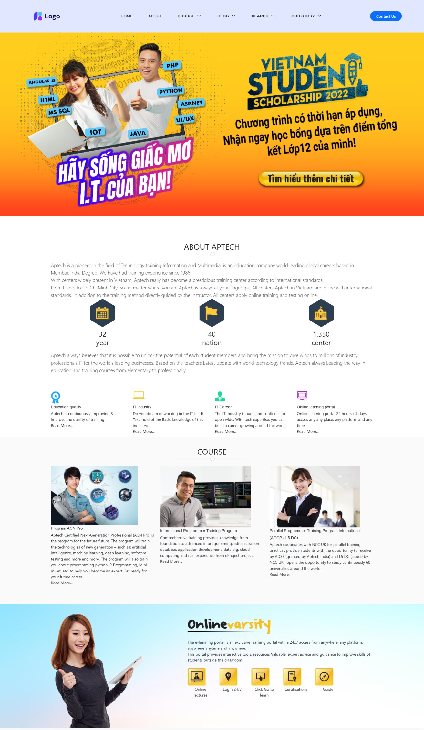
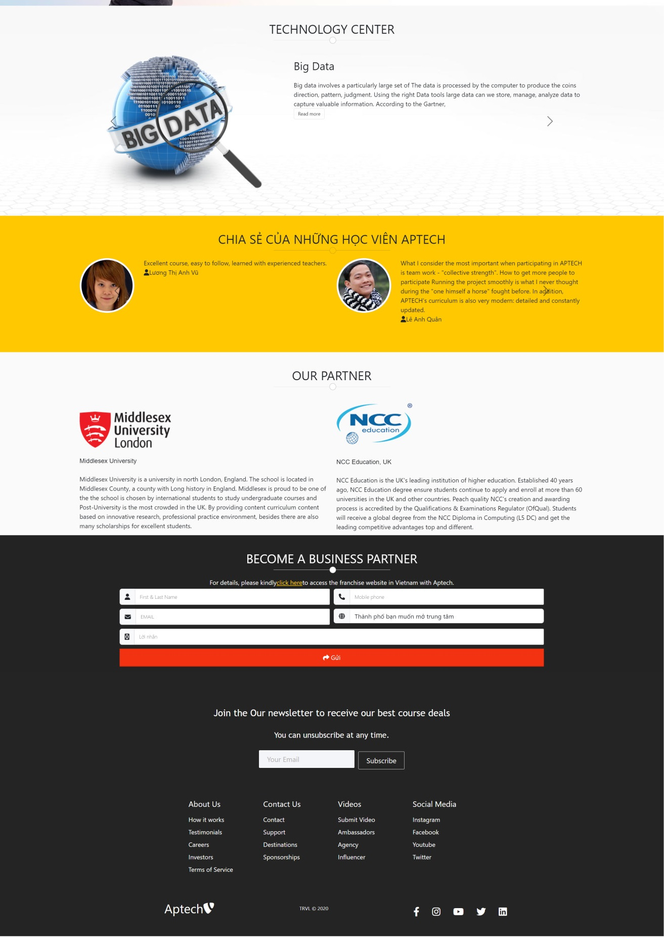
HOME PAGE
This is the page where the user will be navigated after successful access to the website. Home page gives us overview of the information teachers, tells us about the journeys they have gone through.

Slide 9
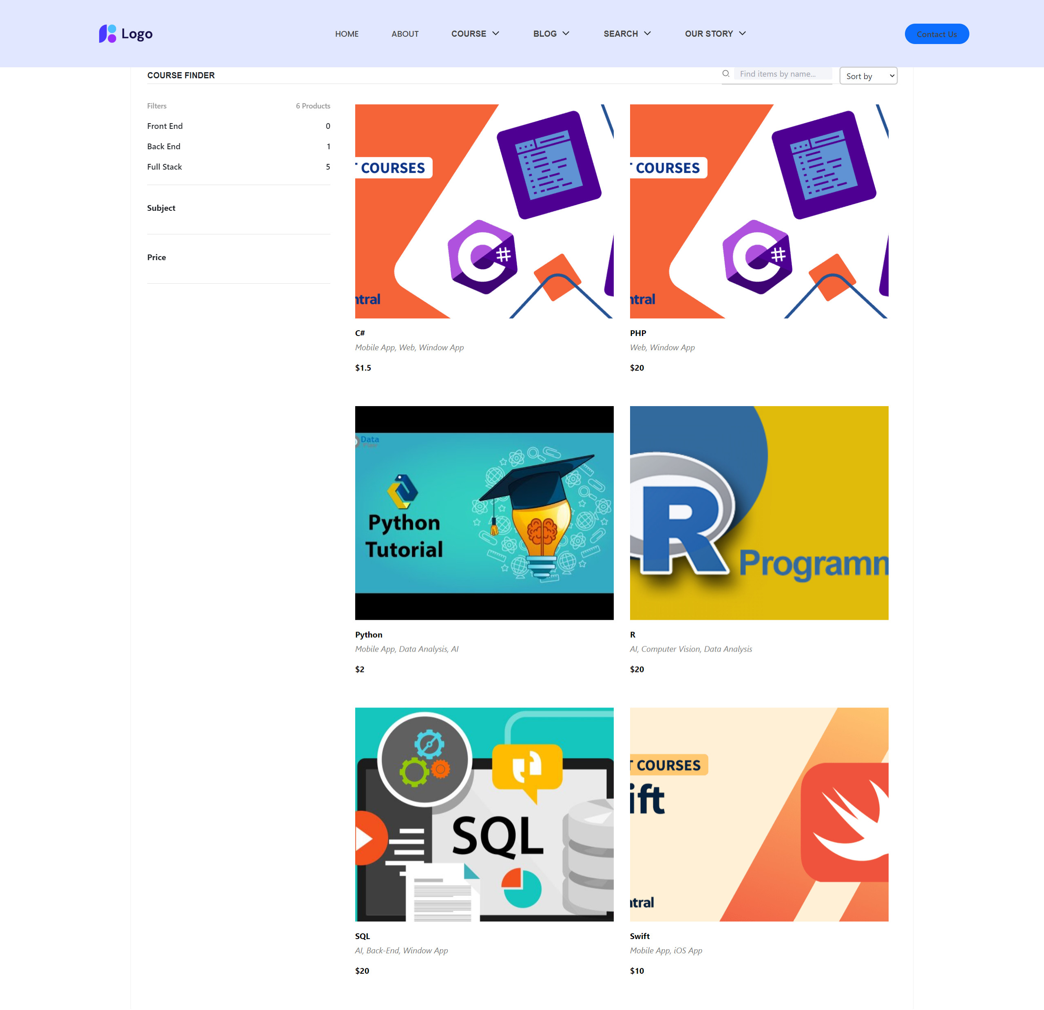
COURSE PAGE
This page also provides a search feature. The viewer can search for information, courses or subjects which they are interested in. After that, the users can be received the list of results, and they can click on the detailed link to discover information.

Slide 10
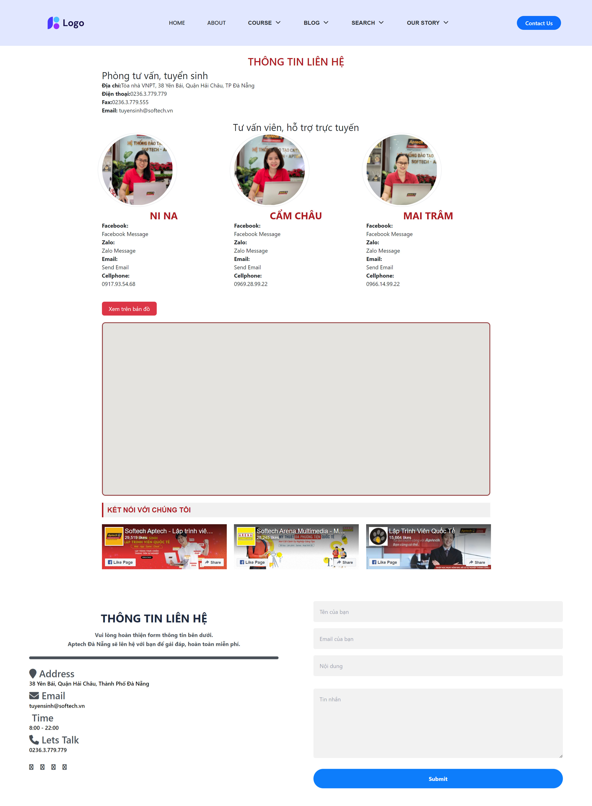
ABOUT PAGE
This page includes the Start Classes address and its location on google map. The viewer can contact us can send their messages to us through the Contact form.

Slide 11

NEWS PAGE
The viewer can read news about technology in this page.

Slide 12
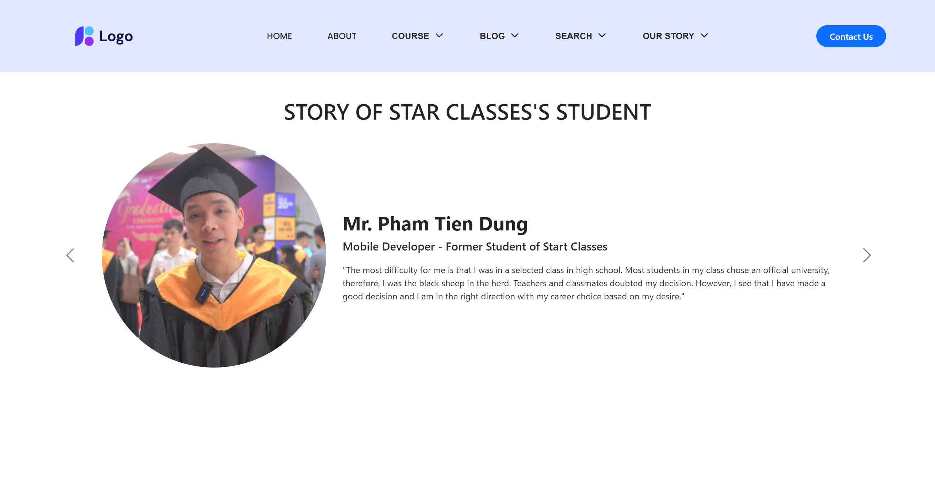
OUR STORY PAGE
This page shows us successful students in previous courses.

Slide 13
IV.
USECASE AND SITE MAP

Slide 14
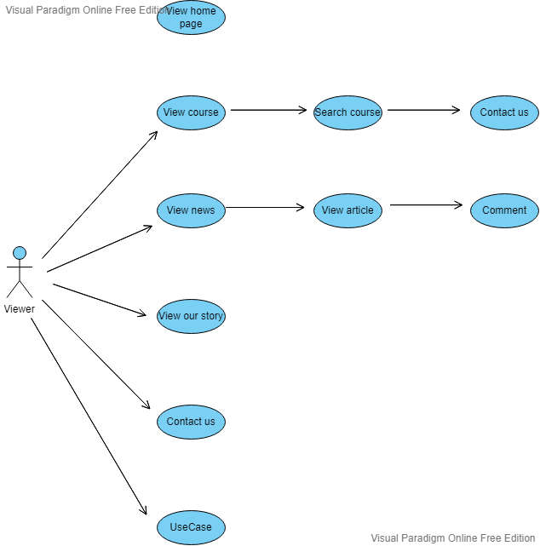
USE CASE DIAGRAM

Slide 15
USE CASE SPECIFICATION
USE CASE SPECIFICATION
Use-case No. | N/A | Use-case Version | N/A
Use-case Name | N/A
Purpose: N/A Input: N/A Output: N/A

Slide 16
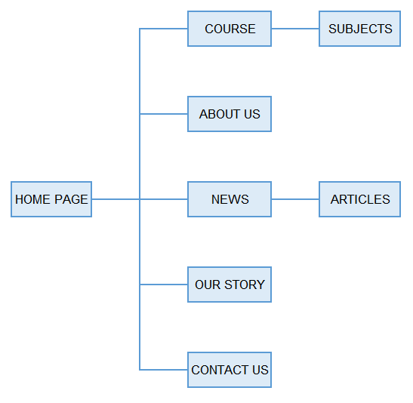
SITE MAP

Slide 17
LAYOUT

Slide 18
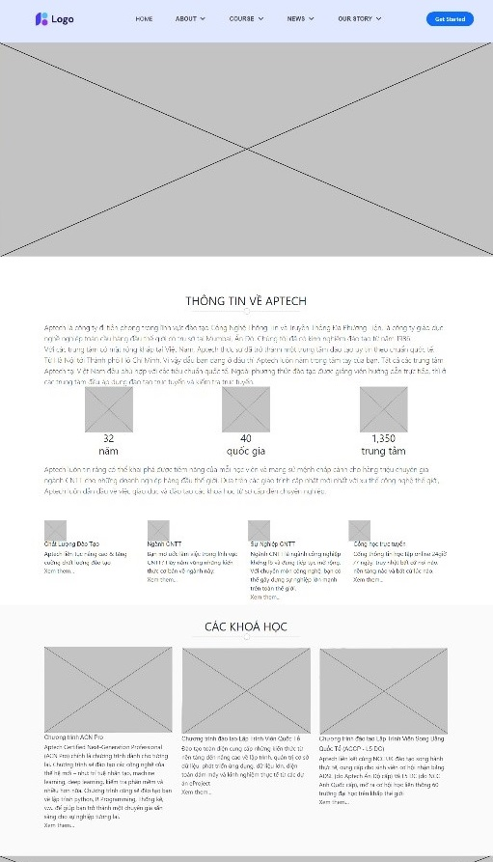
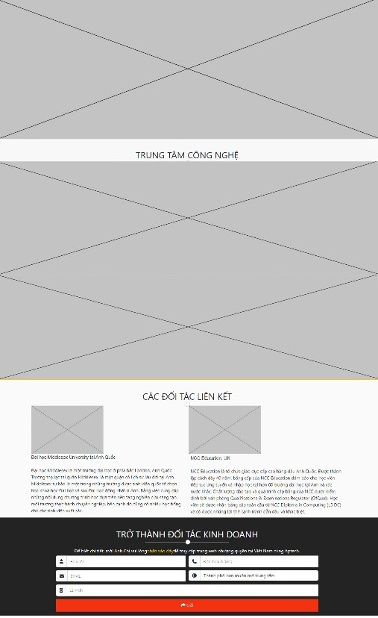
HOME PAGE

Slide 19
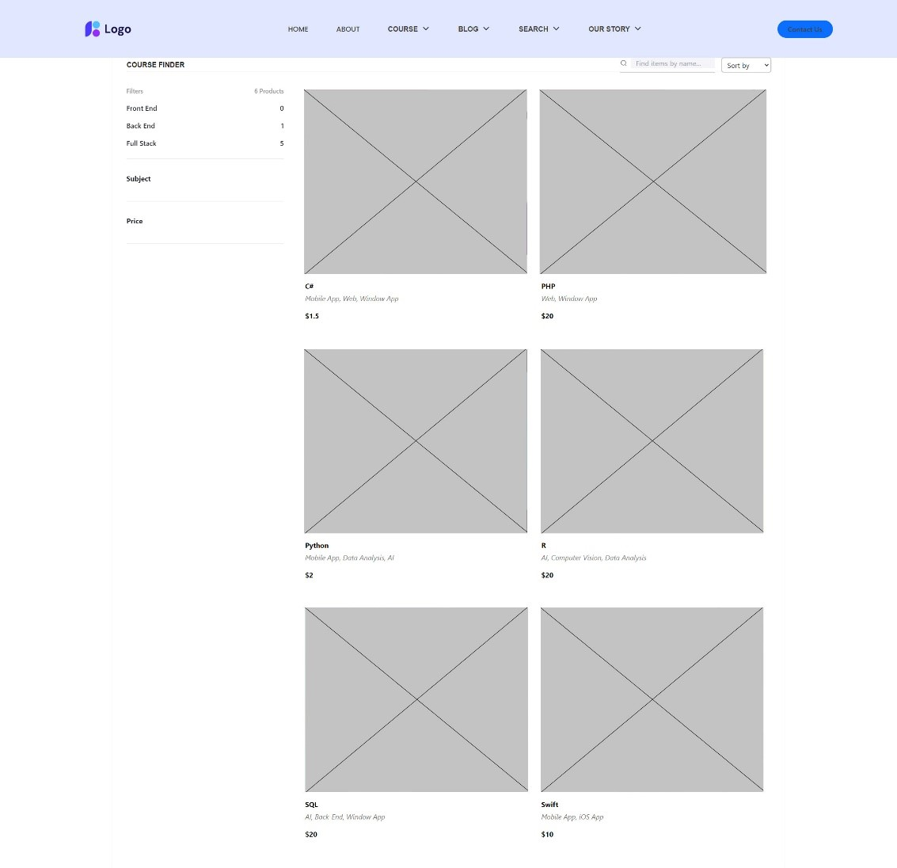
COURSE PAGE

Slide 20
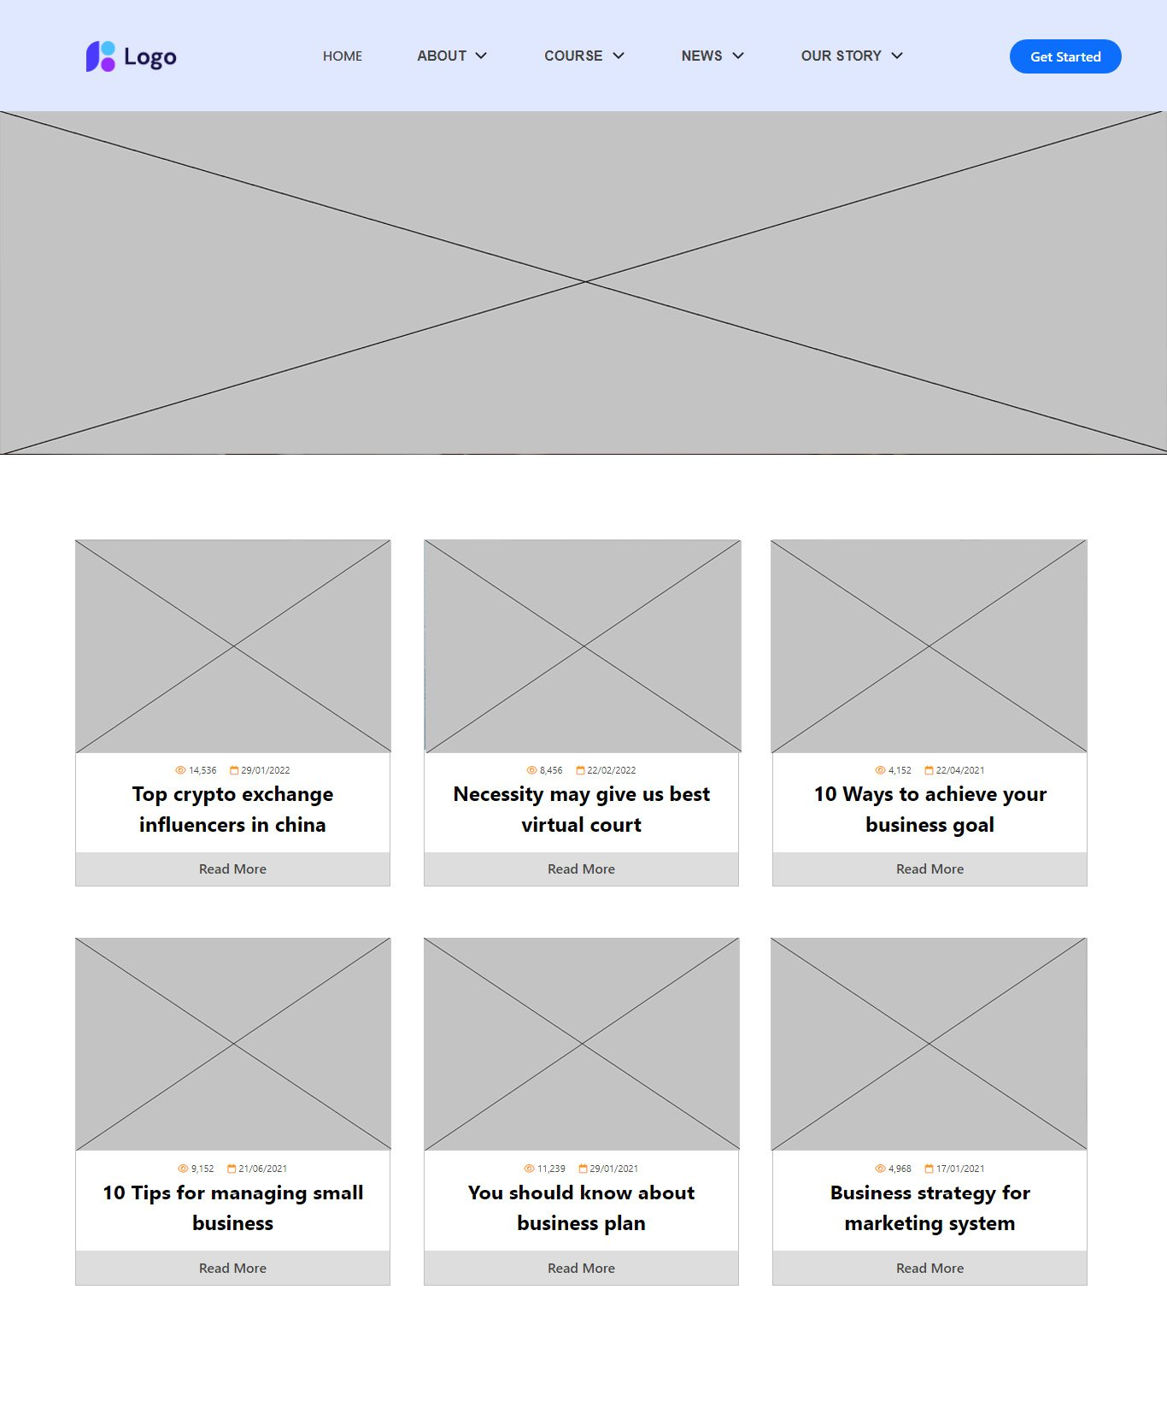
NEWS PAGE

Slide 21
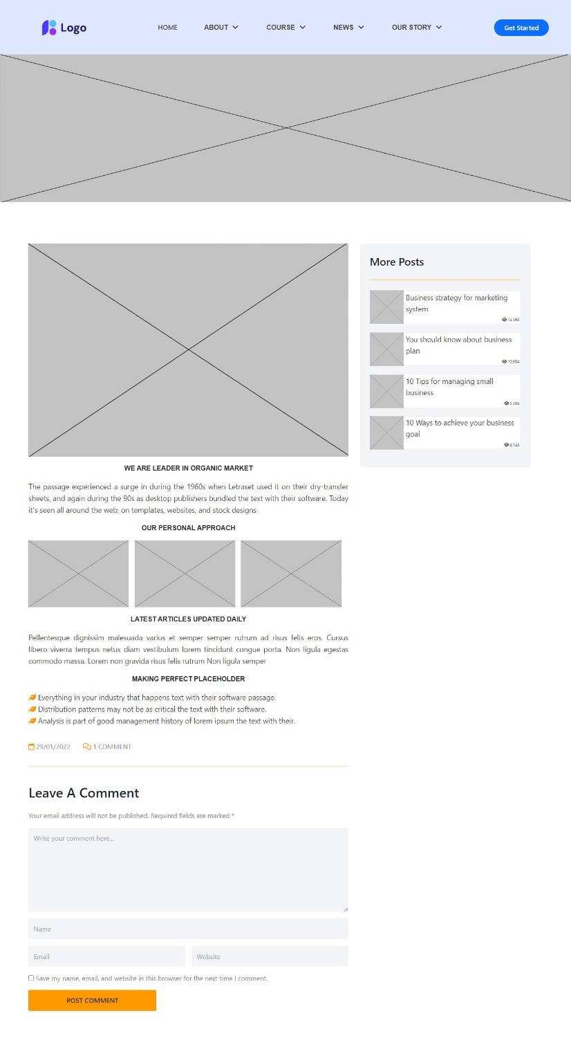
ARTICLES PAGE

Slide 22
V.
TECHNICAL

Slide 23
Software: Visual Studio Code
Web Browser: Opera, Chrome, Firefox support design Responsive
The technique used to build the Website:
HTML5 & CSS.
Reactjs & JavaScrip
Responsive Bootstrap
Validation for bootstrap.
Material for bootstrap:
JS popover.
JS Scrollspy.
Tabs.

Slide 24
VI.
CHECK LIST

Slide 25
CHECK LIST OF VALIDATION
Option | Validate
Fields in forms should not be null | Yes
Are all the program codes working? | Yes
The site name for publishing is unique | Yes
Hyperlinks have tool tip texts | No
Are there functions for the user to enter their comment | Yes
Do all the options present in the application display the correct result? | Yes

Slide 26
SUBMISSION CHECKLIST
No. | Particulars | Yes | No | N/A | Comments
1 | Do all the web pages open? | P
2 | Are all hyperlinks working? | P
3 | Are the web page contents devoid of spelling mistakes? | P
4 | Are all web components working? | P
5 | Is the application user-friendly? | P |  |  | Windows GUI is familiar with everyone

Slide 27
VII.
CONCLUSION

Slide 28
Start Classes is a website that provide information about different courses/subjects taught at the classes, Faculty/Teachers complete information and previous year’s success stories should be listed. Users can also contact directly for questions.
Start Classes website includes: Home page, Planets, Observatories, Gallery, News, Search,…
However, this website also needs more improvement on the interface for computers and mobile phones, need to add algorithms for product search, build web app,…

Slide 29
VIII.
PROJECT PLANNING

Slide 30
No. | Work | Member | Status
1 | Home page | Tien | Done
2 | Course/Search, Filter | Tien | Done
3 | Project structure | Tien | Done
3 | News | Ngoc | Done
4 | Articles | Ngoc | Done
5 | Our Story | Ngoc | Done
6 | Contact | Lan | Done
7 | Course Detail/ Lay out Design | Huy | Done

Slide 31
IX.
REFERENCE

Slide 32
We consulted information on the websites:
https://reactjs.org/
http://www.w3schools.com/
http://www.getbootstrap.com/

Slide 33
THANKS FOR WATCHING
Any questions?

